Slide 1








ProvTools Painlessly Provides Provenance
Aaron M. Ellison, Emery Boose, Orenna Brand, Elizabeth Fong, Matthew K. Lau, Barbara S. Lerner, Thomas Pasquier, Joseph Wonsil, and Margo I. Seltzer

Slide 2
Data provenance is a formal representation of the context and execution of a computation
Notes:
Data provenance is a formal representation of the context and execution of a computation. This
information is represented as a directed acyclic graph (DAG), a structure amenable to computational
analysis. We use the World Wide Web Consortium (W3C) standard for data provenance:
PROV-DM. Figure 1 shows a simple provenance graph. Vertices represent entities (representing
data), activities (representing actions or transformations), and agents (representing users or organizations).
In this figure, a process, controlled by Scientist Sarah, uses an executable function
(a program) and an input file (data) to generate an output. (Pasquier et al. 2018 IEEE Computing in Science & Engineering

Slide 3
Provenance adds value to scientific results
Increases understanding
Improves interpretation
Enables reproducibility
Confers trust
Notes:
But, domain researchers don’t routinely collect provenance despite the existence of tools to collect it.

Slide 4
rdt
(a.k.a. RDataTracker)
github.com/End-to-end-provenance/rdt
rdtLite
CRAN
Notes:
The first step is collecting provenance. rdtLite is available on CRAN whereas rdt is available on github (https://github.com/End-to-end-provenance/rdt). rdtLite is more stable but collects less detailed provenance than rdt does. The additional provenance collected by rdt includes fine-grained provenance internal to functions and internal to control constructs. Both tools output their provenance using the same JSON format.

Slide 5
Collect Provenance
Use Provenance
Store Provenance
Notes:
We have spent many years developing tools like rdt and rdtLite, but despite the existence of tools to collect provenance, domain researchers don’t collect provenance for provenance’s sake
But they might use useful tools that use provenance.

Slide 6
Collect Provenance
Use Provenance
Store Provenance
Notes:
So after many years of working on methods and associated tools to collect provenance (and our working tool, rdtLite, is now on CRAN), we have recently turned our attention to developing tools that use the provenance so that it can be collected and stored behind the scenes.

Slide 7
The ProvTools (rdtLite) suite: Design principles
Trust
Documentation: provSummarizeR (github)
Traceability
Code cleanup and streamlining: Rclean (CRAN)
Debugging: provDebugR (github)
Visualization: provViz (under construction)
Reproducibility
Encapsulation: encapsulator (in revision)
Notes:
provSummarizeR: Reads the provenance created by execution of a script or from commands in the console and provides a human-readable summary identifying the computing environment, libraries used, sourced scripts (if any), and inputs and outputs. It can also optionally save all the files on the provenance directory into a zip file. provSummarizeR uses provenance collected by the rdt or rdtLite packages. (takes in from provParseR).
Rclean: cleans up code for particular outputs
provDebugR: uses provenance to help debug scripts. Calls provParseR, provGraphR
provViz: allows the user to visualize a provenance graph collected by rdt or rdtLite using DDG Explorer (latter is java)
encapsulator: extended VM; written in Ruby, install with gem (linux); see Pasquier et al. 2018 for description

Slide 8
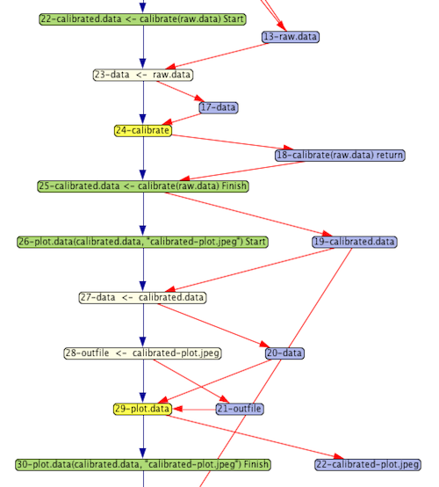
github.com/End-to-end-provenance

